Slide 1

CUSTOMER CARE REGISTRY
EMPATHY MAP CANVAS

Slide 2
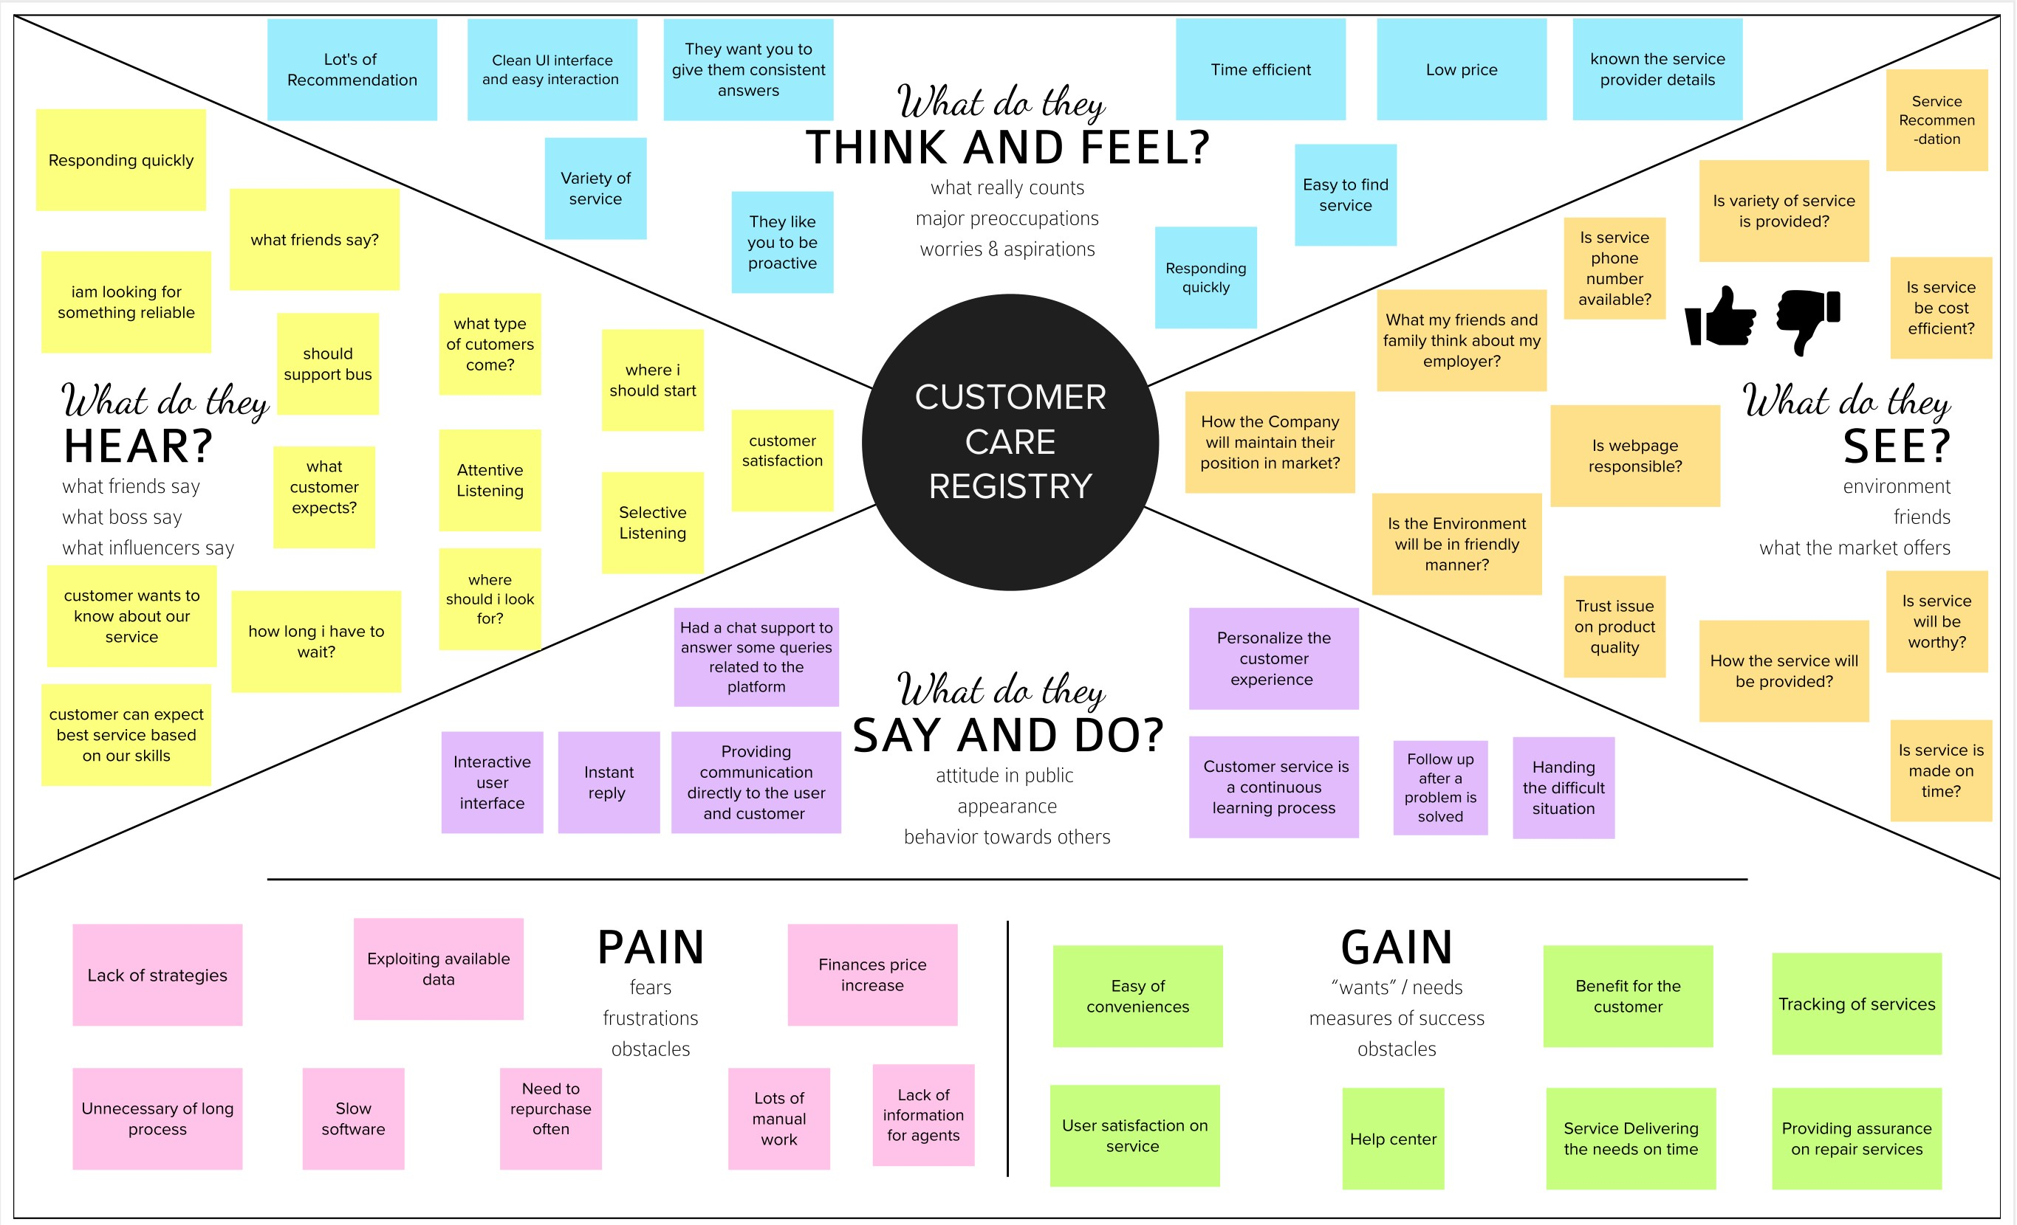
EMPATHY MAP CANVAS
Empathy Map Canvas
4

